Slide 1
LAKEMONTFORT SCHOOL BIOLOGY PORTFOLIO TOPIC:-BIOGEOCHEMICAL CYCLES
BY- KODIDALA TEJORAJASA-9C
.ROLL NO:-19
ADMIN:-5202
TO:- BIOLOGY TEACHER

Slide 2
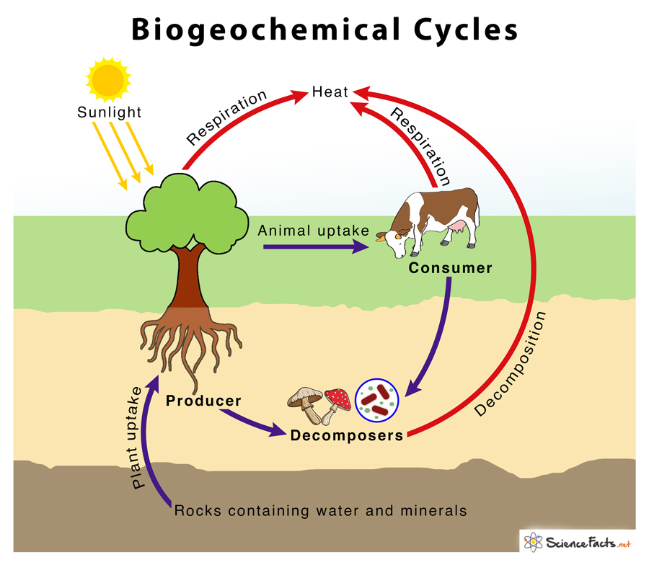
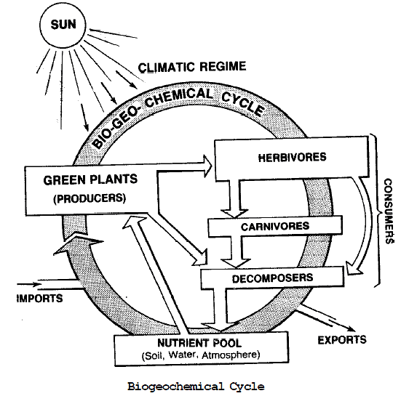
Introduction:-
BIOGEOCHEMICAL CYCLES:-
Biogeochemical cycles mainly refer to the movements of nutrients and other elements between biotic and abiotic factors.
The term Biogeochemical is derived from “Bio” meaning Biosphere and “chemical” meaning the geochemical components and “chemical” meaning the elements that move through a cycle.

Slide 3
IMPORTANCE OF BIOGEOCHEMICAL CYCLES These Biogeochemical Cycles demonstrate the way in which the energy is based . These cycles depict the association between living and non-living,in the ecosystem and enable the continuous survival of ecostsyem .It is comprehend these cycles as leave their effect on living entities.

Slide 4
types of biogeochemical cycles
Biogeochemical cycles are basically divided into two types:-
GASEOUS CYCLES
Gaseous cycles are a type of biogeochemical cycle in which the reservoir in the air or the oceans . These includes carbon. Oxygen, Nitrogen and the water cycles
SEDIMENTARY CYCLES
Sedimentary cycles are a types of cycles of Biogeochemical cycle in which the reservoir is earths crust . These include those of iron, calcium, phosphorus and other non-earthbound elements .

Slide 5
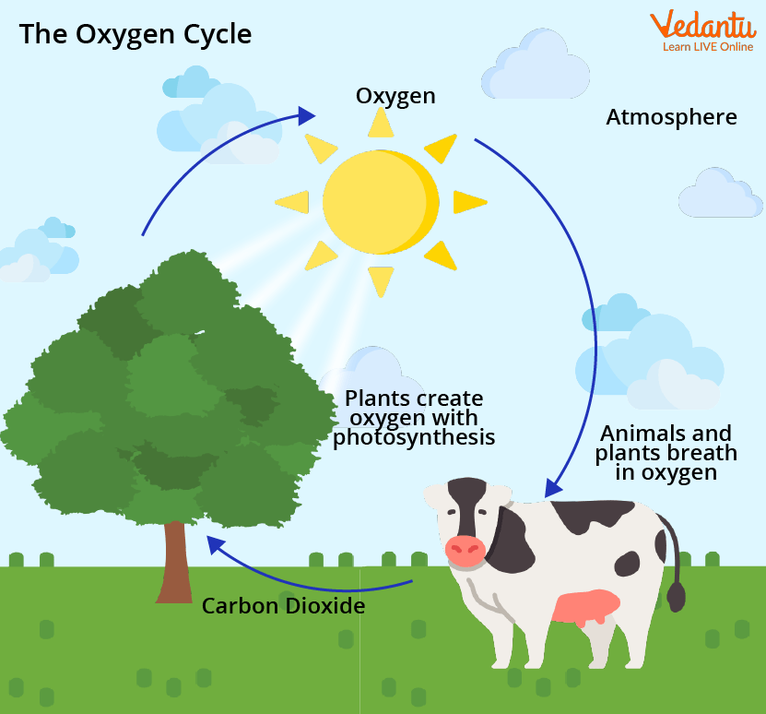
HERE ARE TYPES OF GASEOUS BIOGEOCHEMICALCYCLES
OXYGEN CYCLE :-The oxygen cycle is mainly involved in maintaining the level of oxygen in the atmosphere. The entire cycle can be summarized as, the oxygen cycle begins with the process of photosynthesis in the presence of sunlight, releases oxygen back into the atmosphere , which humans and animals breathe in oxygen and breath out carbon dioxide, and again linking back to the plants .This also proves that both the oxygen and carbon cycle occur independently and are interconnected to each other.

Slide 6
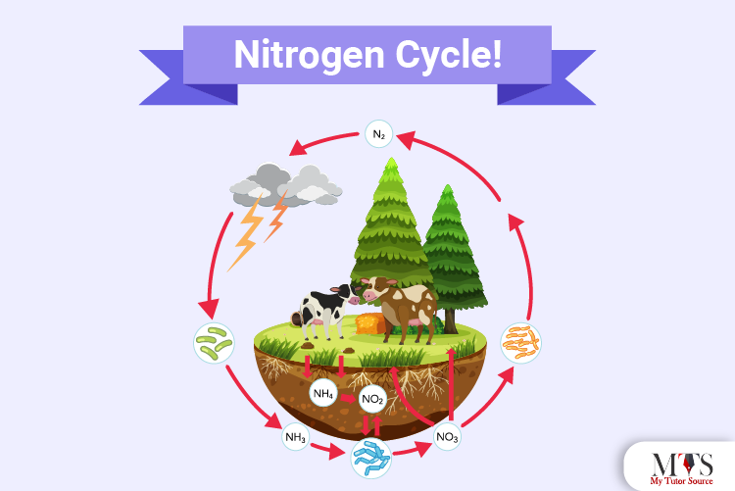
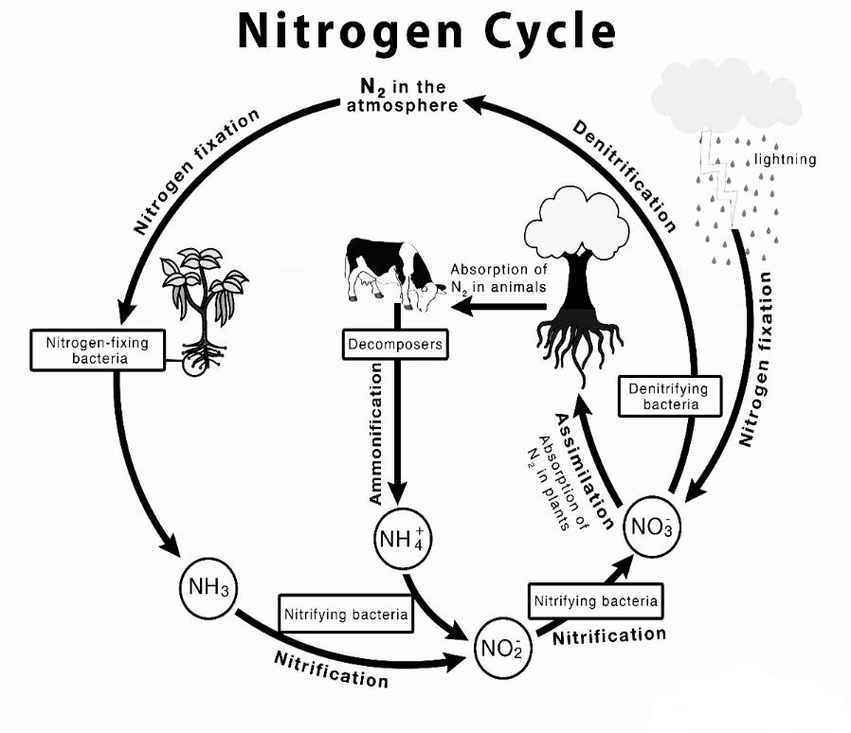
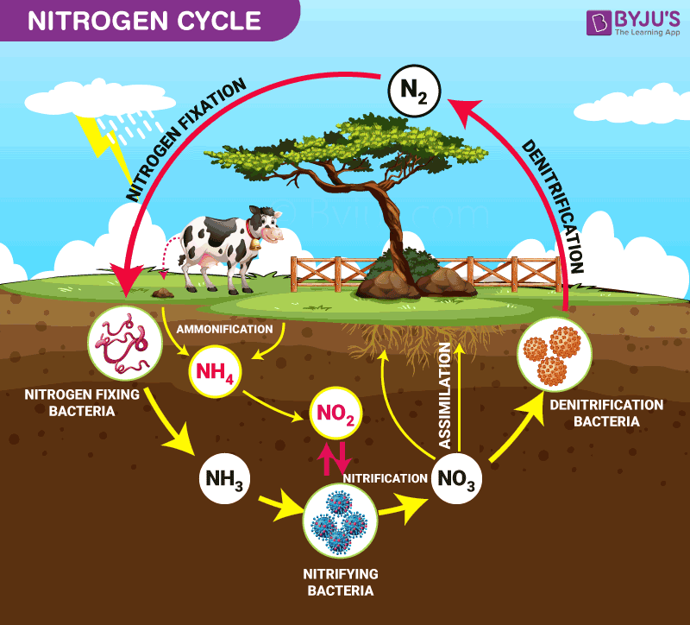
NITROGEN CYCLE :-
Nitrogen cycle
Nitrogen cycle is a biogeochemical process through which nitrogen is converted into many forms , consecutively passing from the atmosphere to the soil to organism and back into the atmosphere . It involves several process such as nitrogen fixation , nutrification, denitrification ,decay and putrefaction .

Slide 7
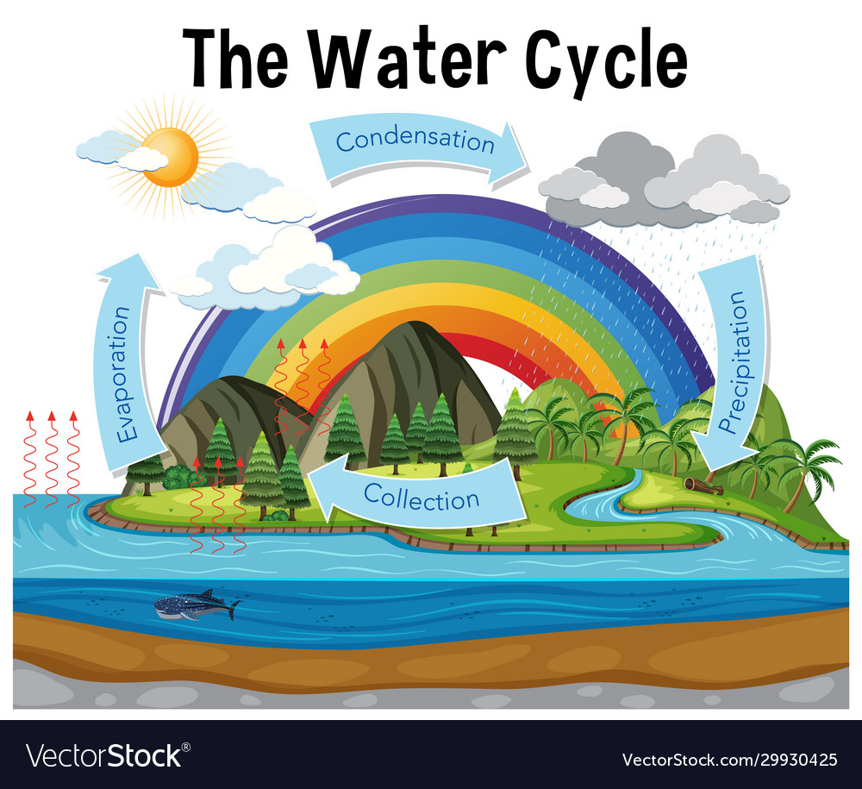
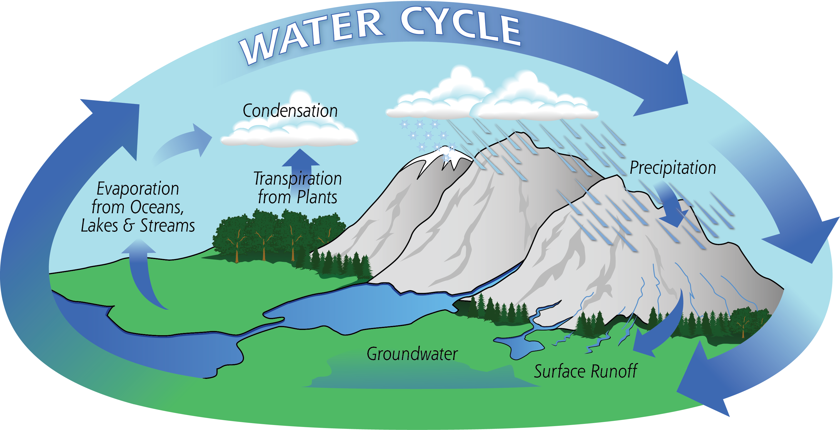
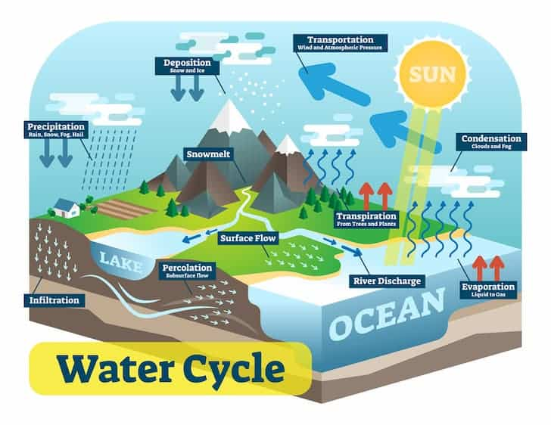
WATER CYCLE:
Water cycle
Water cycle
Water cycle
The water cycle shows the continuous movement of water within the earth and atmosphere. It is a complex system that includes many different processes . Liquid water evaporates into water vapour , condenses to form clouds, and precipitates back to earth in the form of rain and snow.
Continuous movement

Slide 8
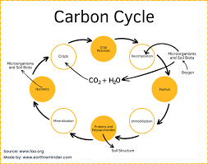
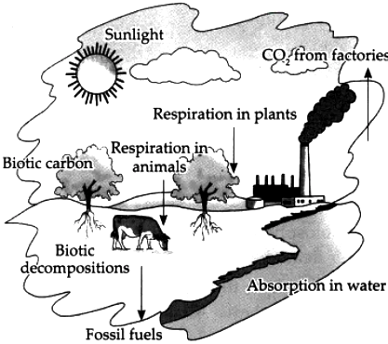
CARBON CYCLE:-
Carbon -cycle
Carbon cycle
Carbon cycle
The carbon cycle is natures way of reusing carbon atoms, which travel from the atmosphere into organisms in the earth and then back into the atmosphere over and over again.

Slide 9
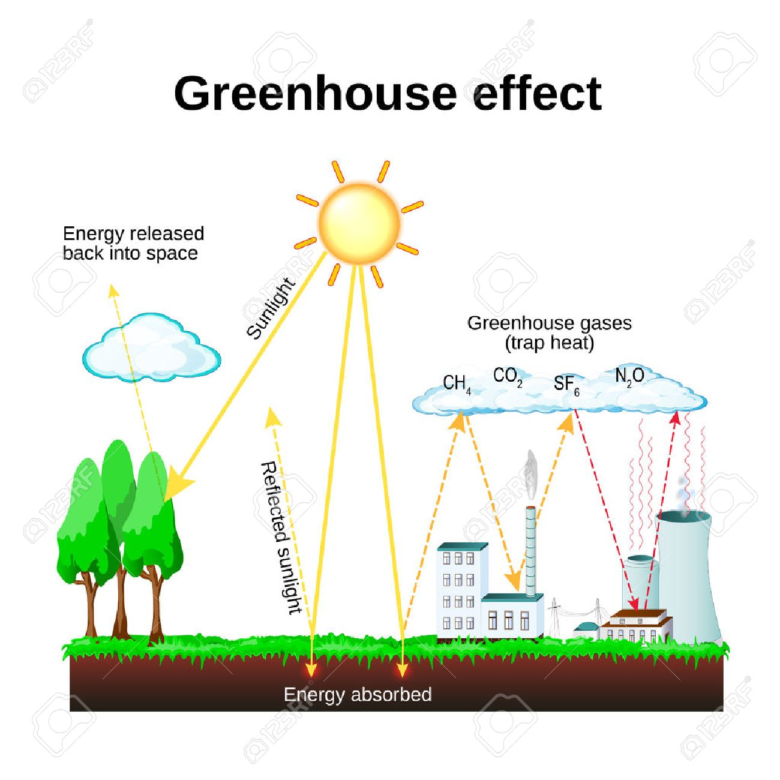
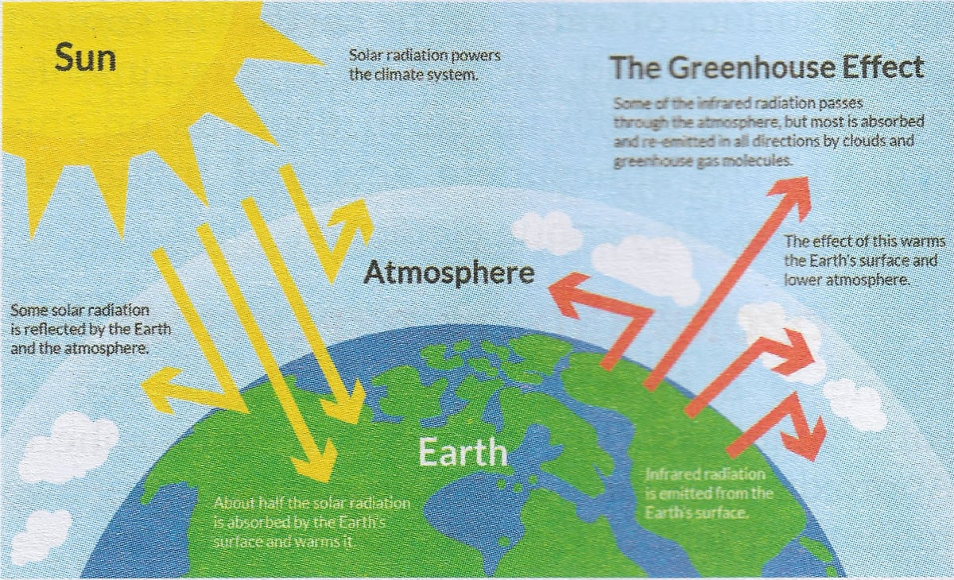
Carbon Cycle includes :-
GREEN HOUSE EFFECT :-
Greenhouse effect
Green house effect
The greenhouse effect is the way in which heat is trapped close to earth’s surface by “greenhouse gases”. These heat trapping gases can be thought of a blanket wrapped around earth , keeping the planet toastier that it would be without them .

Slide 10

ACKNOWLEDGEMENT:-
Firstly, l would like to thank the Almighty , the Most Gracious and Most Merciful , who gave me the strength to complete the task effectively. Secondly ,l would like to thank our Principal Rev. Bro Jenny Kuriakose for giving this golden opportunity .
Last but not the least ,I would like to express my heartfelt gratitude to my Biology Teacher for giving us the opportunity to work on such a fascinating project , which helped me in doing a lot of research and l come to know about so many new things.

